Slide 1





Source Control Systems
Git, GitHub
SoftUni Team
Technical Trainers
Software University
http://softuni.bg

Slide 2
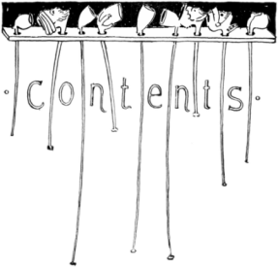
Table of Contents
Version Control Systems: Philosophy
Versioning Models
Centralized Version Control
Distributed Version Control
Git – Demo + Exercise
Project Hosting Sites
GitHub - Demo

Slide 3
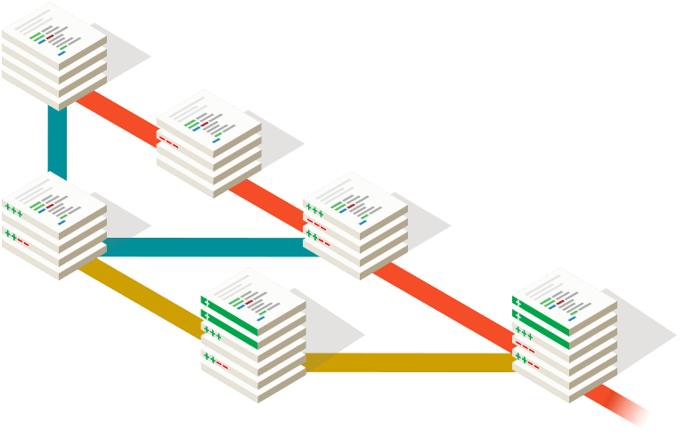


Version Control
Managing Different Versions of the Same File / Document

Slide 4

Version Control Systems (VCS)
Functionality
File versions control
Merge and differences search
Branching
Console and IDE plugins
Well known products
CVS, Subversion (SVN) – free, open source
Git, Mercurial – distributed, free, open source
Microsoft TFS – commercial

Slide 5
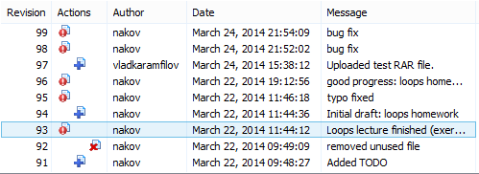
Version Control (Revision Control)
Constantly used in software engineering
During the software development
While working with documents
Changes are identified with an increment of the version number
for example 1.0, 2.0, 2.17
Version numbers are historically linked with the person who created them
Full change logs are kept

Slide 6
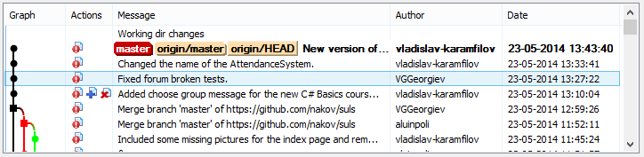
Change Log
Systems for version control keep a complete change log (history)
The date and hour of every change
The user who made the change
The files changed + old and new version
Old versions can be retrieved, examined and compared
It is possible to return to an old version (revert)

Slide 7
Vocabulary
Repository (source control repository)
A server that stores the files (documents)
Keeps a change log
Revision, Version
Individual version (state) of a document that is a result of multiple changes
Check-Out, Clone
Retrieves a working copy of the files from a remote repository into a local directory
It is possible to lock the files

Slide 8
Vocabulary (2)
Change
A modification to a local file (document) that is under version control
Change Set / Change List
A set of changes to multiple files that are going to be committed at the same time
Commit, Check-In
Submits the changes made from the local working copy to the repository
Automatically creates a new version
Conflicts may occur!

Slide 9
Vocabulary (3)
Update, Get Latest Version, Fetch / Pull
Download the latest version of the files from the repository to a local working directory + merge conflicting files
Undo Check-Out, Revert / Undo Changes
Cancels the local changes
Restores their state from the repository
Branch / Branching
Division of the repositories in a number of separate workflows

Slide 10

Version Control: Typical Scenario
Users
Repository
Main
development
line (trunk)
User X
Version A Branch
Version A.1 Branch
Check Out
Check In
C
A
User Y
B
Version B Branch
Check Out
D
Merge
E
Check In

Slide 11
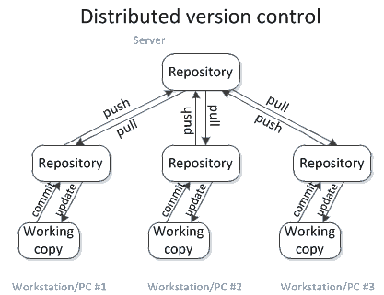
Distributed Version Control
Source: http://homes.cs.washington.edu/~mernst/advice/version-control.html

Slide 12
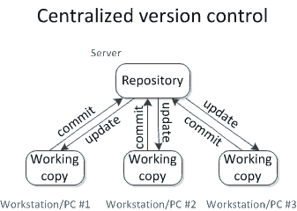
Centralized Version Control
Source: http://homes.cs.washington.edu/~mernst/advice/version-control.html

Slide 13

Merging Problems
When a file is concurrently modified, changes should be merged
Merging is hard!
It is not always automatic process
Coordination and responsibility between the developers is required
Commit changes as early as finished
Do not commit code that does not compile or blocks the work of the others
Leave meaningful comments at each commit

Slide 14


The "Distributed Version Control" Versioning Model

Slide 15

Working with Git

Slide 16



Using Git Bash
Live Demo

Slide 17

What is Git?
Git
Distributed source-control system
Work with local and remote repositories
Git bash – command line interface for Git
Free, open-source
Has Windows version (msysGit)
http://msysgit.github.io
https://www.atlassian.com/git/tutorials/setting-up-a-repository

Slide 18
Installing Git
msysGit Installation on Windows
Download Git for Windows from: http://msysgit.github.io
“Next, Next, Next” does the trick
Options to select (they should be selected by default)
“Use Git Bash only”
“Checkout Windows-style, commit Unix-style endings”
Git installation on Linux:
sudo apt-get install git

Slide 19
Basic Git Commands
Cloning an existing Git repository
Fetch and merge the latest changes from the remote repository
Preparing (adding / selecting) files for a commit
Committing to the local repository
git clone [remote url]
git pull
git add [filename] ("git add ." adds everything)
git commit –m "[your message here]"

Slide 20
Basic Git Commands (2)
Check the status of your local repository (see the local changes)
Creating a new local repository (in the current directory)
Creating a remote (assign a short name for remote Git URL)
Pushing to a remote (send changes to the remote repository)
git status
git init
git remote add [remote name] [remote url]
git push [remote name] [local name]

Slide 21
Using Git: Example
mkdir work
cd work
git clone https://github.com/SoftUni/test.git
dir
cd test
dir
git status
(edit some file)
git status
git add .
git commit -m "changes"
git push

Slide 22

Through an IDE plugin – IntelliJ IDEA
Live Demo
The idea is important

Slide 23


Distributed Version Control (1)
Andy and Bobby clone the remote repository locally.
They both have the same files in their local repositories.
Remote Repository (Server)
A
Clone
Clone
A
A
Local Repository
(Andy)
Local Repository
(Bobby)
Andy
Bobby

Slide 24
Distributed Version Control (2)
Remote Repository (Server)
Andy and Bobby work locally on a certain file A.
A
(Local Edit)
(Local Edit)
Andy
A
A
Bobby
Local Repository
(Andy)
Local Repository
(Bobby)
Andy
Bobby

Slide 25
Distributed Version Control (3)
Andy and Bobby commit locally the modified file A into their local repositories.
Remote Repository (Server)
A
Commit (locally)
Commit (locally)
Andy
Andy
Bobby
Bobby
Local Repository
(Andy)
Local Repository
(Bobby)
Andy
Bobby

Slide 26
Distributed Version Control (4)
Andy pushes the file A to the remote repository.
Still no conflicts occur.
Remote Repository (Server)
Andy
Push
Andy
Andy
Bobby
Bobby
Local Repository
(Andy)
Local Repository
(Bobby)
Andy
Bobby

Slide 27
Distributed Version Control (5)
Bobby tries to push her changes.
A versioning conflict occurs.
Remote Repository (Server)
Andy
Push (conflict)
Andy
Andy
Bobby
Bobby
Local Repository
(Andy)
Local Repository
(Bobby)
Andy
Bobby

Slide 28
Distributed Version Control (6)
Bobby merges the her local files with the files from the remote repository.
Conflicts are locally resolved.
Remote Repository (Server)
Andy
Pull (Fetch + Merge)
Andy
Andy
Bobby
+Andy
Bobby
+Andy
Local Repository
(Andy)
Local Repository
(Bobby)
Andy
Bobby

Slide 29
Distributed Version Control (7)
Remote Repository (Server)
Bobby commits her merged changes.
No version conflict.
Bobby
+Andy
Andy
Push (no conflict)
Andy
Andy
Bobby
+Andy
Bobby
+Andy
Local Repository
(Andy)
Local Repository
(Bobby)
Andy
Bobby

Slide 30
Distributed Version Control (8)
Andy pulls (updates) the changed files from the remote repository.
Remote Repository (Server)
Bobby
+Andy
Andy
Pull
Bobby
+Andy
Bobby
+Andy
Bobby
+Andy
Bobby
+Andy
Local Repository
(Andy)
Local Repository
(Bobby)
Andy
Bobby

Slide 31
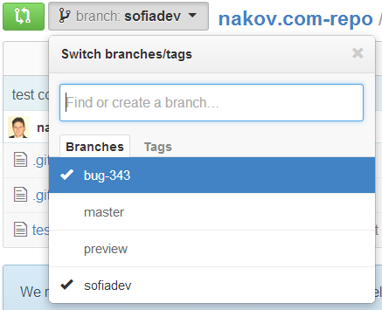
Branching
Branching allows splitting the development line into separate branches
Different developers work in different branches
Branching is suitable for:
Development of new feature or fix in a new version of the product (for example version 2.0)
Features are invisible in the main development line
Until merged with it
You can still make changes in the older version (for example version 1.0.1)

Slide 32
Branching – Example
DE 2.1
Branch ->
DE
DE 2.0
Branch ->
EN
EN 2.0
EN 3.0
EN 4.0
Main trunk
(remote master)
File A
Branch 1.2.4. ->
FR
FR 2.0
FR 3.0

Slide 33

Project Hosting and Team Collaboration Sites
GitHub, SourceForge, Google Code, CodePlex, Project Locker

Slide 34
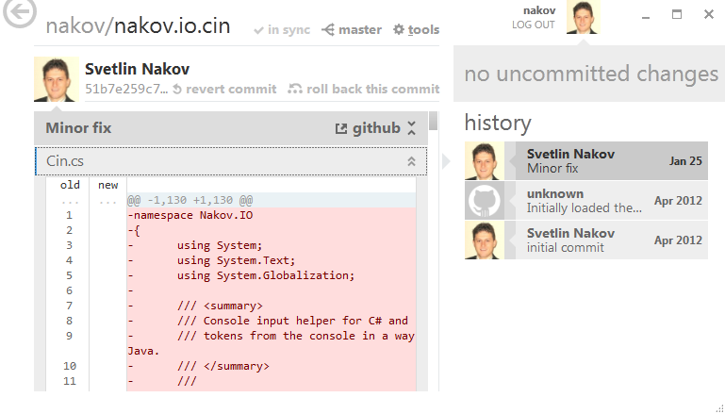
Project Hosting Sites
GitHub – https://github.com
The #1 project hosting site in the world
Free for open-source projects
Paid plans for private projects
GitHub provides own Windows client
GitHub for Windows
http://windows.github.com
Dramatically simplifies Git
For beginners only

Slide 35
Project Hosting Sites
Bitbucket – http://bitbucket.org
Source control (Mercurial), issue tracker, wiki, management tools
Private projects, free and paid editions
Others: Unfuddle, XP-Dev, Beanstalk
SourceForge – http://www.sourceforge.net
Source control (SVN, Git, …), web hosting, tracker, wiki, blog, mailing lists, file release, statistics, etc.
Free, all projects are public and open source

Slide 36
Project Hosting Sites (2)
CodePlex – http://www.codeplex.com
Microsoft's open source projects site
Team Foundation Server (TFS) infrastructure
Source control (TFS), issue tracker, downloads, discussions, wiki, etc.
Free, all projects are public and open source
Google Code – http://code.google.com/projecthosting/
Source control (SVN), file release, wiki, tracker
Very simple, basic functions only, not feature-rich
Free, all projects are public and open source
1-minute signup, without heavy approval process

Slide 37
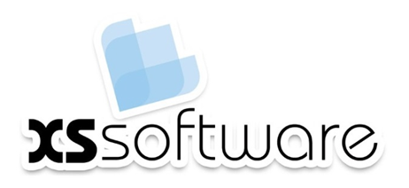







Source Control Systems
http://softuni.org/courses

Slide 38
License
This course (slides, examples, demos, videos, homework, etc.) is licensed under the "Creative Commons Attribution-NonCommercial-ShareAlike 4.0 International" license
Attribution: this work may contain portions from
"Knowledge Sharing and Team Working" course by Telerik Academy under CC-BY-NC-SA license

Slide 39





Free Trainings @ Software University
Software University Foundation – softuni.org
Software University – High-Quality Education, Profession and Job for Software Developers
softuni.bg
Software University @ Facebook
facebook.com/SoftwareUniversity
Software University @ YouTube
youtube.com/SoftwareUniversity
Software University Forums – forum.softuni.bg

